Slide 1
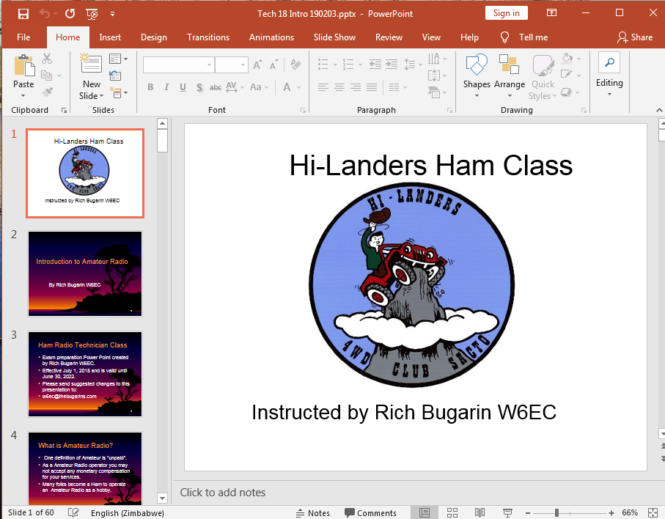
Before You Start
For the best view of this PowerPoint I suggest you are in Slide Show Mode. If all you see is this slide you should be all ready to go.
But if what you see is the designer mode (notice the navigation plane with multi slides) as shown in the photo on the right, then I suggest you manually start the Slide Show (see next slide)

Slide 2
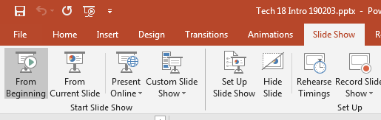
To manually start Slide Show if needed
Left click on “Slide Show”
Then Left click on “From Beginning”
That’s it you should now be on your way.
To advance slide use Lift click or mouse scroll or space bar or left/right arrows. For more options Right click

Slide 3

Hi-Landers Ham Class
Instructed by Rich Bugarin W6EC

Slide 4
Introduction to Amateur Radio
By Rich Bugarin W6EC

Slide 5
Ham Radio Technician Class
Exam preparation Power Point created by Rich Bugarin W6EC.
Effective July 1, 2022 and is valid until June 30, 2026.
Please send suggested changes to this presentation to:
w6ec@thebugarins.com

Slide 6
What is Amateur Radio?
One definition of Amateur is “unpaid”.
As a Amateur Radio operator you may not accept any monetary compensation for your services.
Many folks become a Ham to operate an Amateur Radio as a hobby.

Slide 7
Amateur Radio Main Purpose
The Amateur Radio service provides voluntary noncommercial communications to the public, particularly in times of emergency. The service also increases the number of trained radio operators and electronics experts, and improves international goodwill.

Slide 8
Why are we called Hams
Some say it is because we joke around a lot.
Others say it was an old telegraph operators terminology for an operator that was new and some what incompetent.

Slide 9
Definitions:
Amateur operator: A person holding a written authorization to be the control operator of an amateur station.
Amateur station: A station in an amateur radio service consisting of the apparatus necessary for carrying on radio communications.

Slide 10
Definitions continued:
The Federal Communications Commission (FCC) enforces the rules and grants Amateur Radio licenses in the United States.
Before you can control an amateur station you must be named in the FCC amateur license database, or be an alien with reciprocal operating authorization.

Slide 11
How soon can I get on air?
You can transmit as soon as your license grant appears in the FCC's Universal Licensing Service (ULS) database. This database is on the Internet at FCC.GOV
After the license is granted you are allowed to transmit within the privileges of your license.

Slide 12
License
Cost to obtain a license is typically less than $20 the test administrators (VE’s) do not get paid for there services but they do ask for a small fee to cover there expenses.
Your license will be good for 10 years.
License renewal is free.

Slide 13
Keep your address current
If the FCC mails you any correspondence and the mail is returned to them do to incorrect address the FCC will cancel your license.
Updating your contact information is free and can be easily done on the FCC ULS internet site.

Slide 14
New FCC Requirements
All new applicants need a FRN number if you don’t have one you need to apply on the FCC.GOV web site.
All FRN holders now have to have an e-mail associated with there FRN. Use the CORES system in FCC.GOV

Slide 15
Where do I take the test?
The exam (V.E. session) is typically given by local ham clubs A local list is included in the class folder. A full list of local VE sessions can be found of the ARRL web sight also some are listed on the Ham page at HI-LANDERS.COM

Slide 16
What radio should I get?
Radios fall into 3 categories.
Base Station (120 volt)
Mobile (12 volt)
Hand Held (called Handy Talkie or HT)
Most Hi-Landers club members operate on the 2 Meter band. The 2M band is used during our Poker Run.

Slide 17
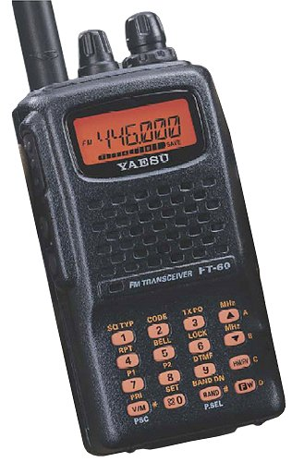
Popular Hi-Landers Radio
Many of the Hi-Landers have selected the Yaesu FT-60 HT Radio for around $200
It is a duel band 2 meter/70 cm 5 watt HT with 1000 memory channels.
I can program this radio for you with a computer program.

Slide 18
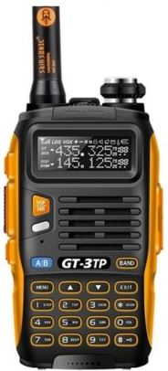
Hi-Landers Alternate HT Radio
A very popular HT Radio from China is the Baofeng Radio for under $50
It is a duel band 2 meter/70 cm 8 watt HT with 128 memory channels.
I can program this radio for you with a computer program.

Slide 19
HT Disadvantages
HT’s are popular because of there compact size but this size comes with compromises In power and performance.
To improve performance of your HT
Get a better antenna.
Operate it from a 12 volt power cord.
Add an optional amplifier.

Slide 20
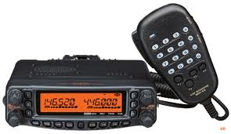
Mobile Radios
If you can afford it a mobile radio will out perform a HT.
Mobile Radio typical output power is between 45 to 65 watts. (more power = further distance)
More features
Some are multi-band
Some can operate as a repeater
Some have a removable face plate

Slide 21
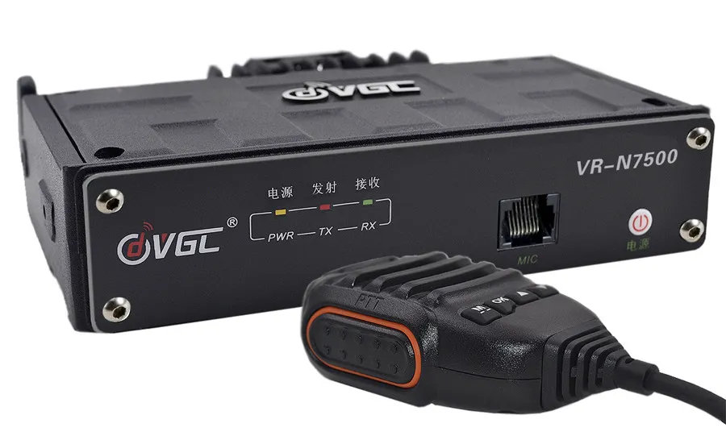
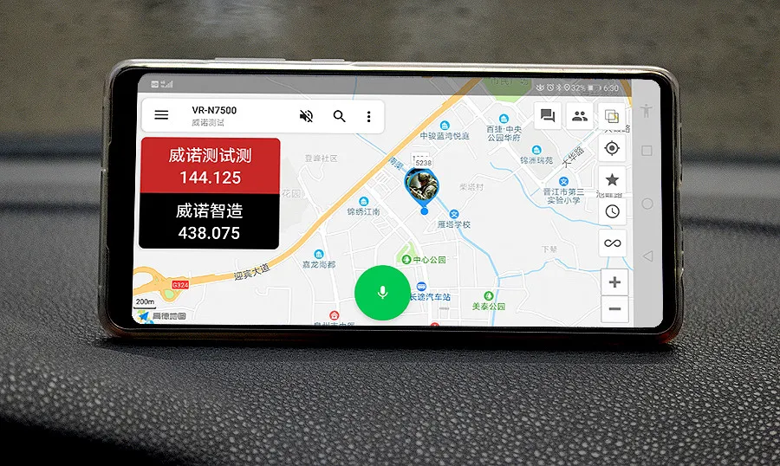
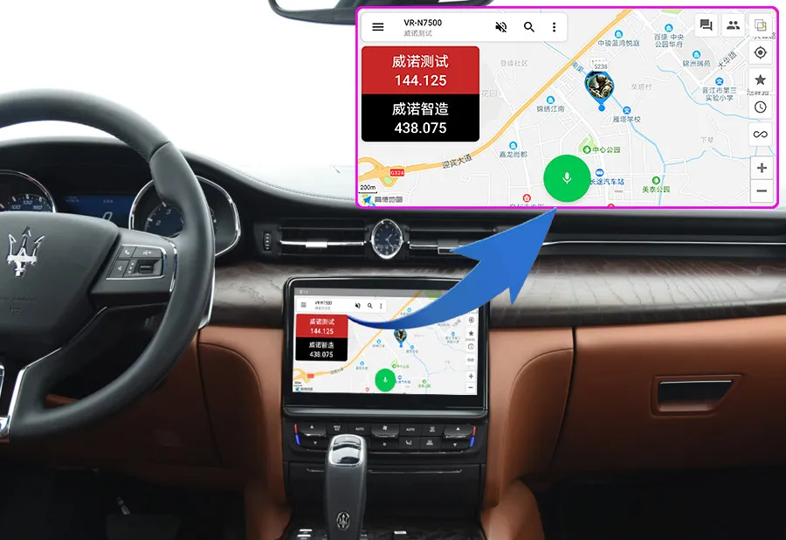
New Smart Radios
A new idea in 50w mobile radios are hybrids that have no face plate and are controlled by Bluetooth from your smart phone or tablet.
Advantages: Remote Access, controlled by app on your smart device.
Has APRS modem built in for using APRS, GPS tracking. Around $200.00

Slide 22
Frequencies
HF stands for High Frequency; HF is defined as frequencies between 3 and 30MHz (CB and Ham 10 meters, it may skip many miles)
VHF stands for Very High Frequency; VHF is defined as frequencies between 30 and 300MHz (Line of sight only)
UHF stands for Ultra High Frequency; UHF is defined as frequencies between 300 and 3,000MHz (Line of sight only)

Slide 23
Technician Class Frequencies
Most Technician Class Ham’s, operate on the 2 meter (VHF) and 70 centimeter (UHF) bands.
Technician Class License allows you to operate within the bands/frequencies listed on the following slides.
May operate with a maximum power of 1500 Watts PEP. (PEP stands for Peak Envelope Power)

Slide 24
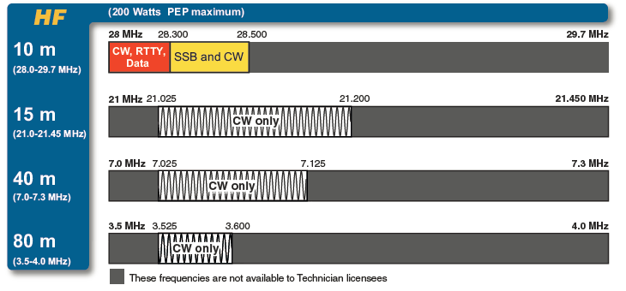
Technician HF Bands
Note: the FT-8900r and TH-9800 Transmit on 10 meters using FM only. As a Tech when on 10 meters, you must us AM-SSB with a maximum power of 200 Watts PEP.
CB is AKA 11 meters and is not within the ham bands.
A ham radio my not transmit on 11 meters as per FCC rules.

Slide 25
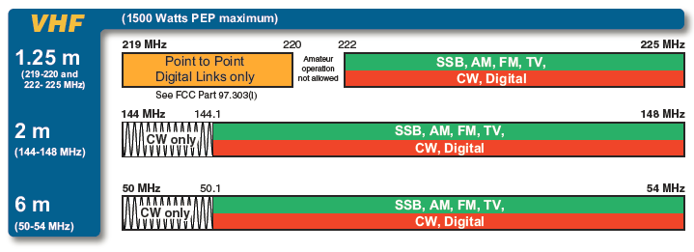
Technician VHF Bands

Slide 26
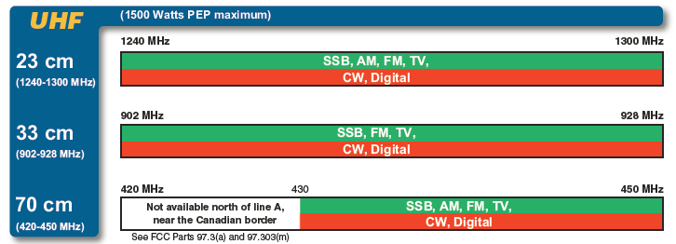
Technician UHF Bands

Slide 27
Common Rules to Follow
When transmitting you are required to ID yourself using your call sign at the beginning (when using a repeater) and at the end of your communication.
If communications exceeds 10 minutes you are required to ID with call sign before the 10 minutes are up and every 10 minutes (or less) thereafter.

Slide 28
More Common Rules
Listen to the frequency before transmitting so you don’t step on (transmit over) another operator.
Use minimum power to get the job done (an FCC Rule); too much power may step on distance stations.

Slide 29
More Common Stuff
Many operators over modulate there transmission by putting the mike too close to their mouth. A suggestion to prevent over modulation is don’t speak directly into the mike hold it sideways by the side of your mouth near your cheek and speak in a normal voice.

Slide 30
More Common Rules
A ham radio is considered a “Radio Telephone” intended as a one on one conversation medium. But it is like a party line where other folks can listen to (monitor) your conversation.
Broadcasting (sending out a transmission intended for multiple listeners) is typically not allowed on a ham radio. Exceptions are a controlled radio net, testing the radio and during emergencies.

Slide 31
More Common Rules
The 10 code like 10-4 is not used by ham operators.
Ham’s use Q-codes & C-codes on HF but usually not on VHF and UHF.
Using a ham radio for personal business, to sell items (other then ham equipment) and transmitting music is not allowed.

Slide 32
10 Codes Used on CB not used on Ham
10-1 Receiving Poorly
10-2 Receiving Well
10-3 Stop Transmitting
10-4 Ok, Message Received
10-5 Relay Message
10-6 Busy, Stand By
10-7 Out of Service, Leaving Air
10-8 In Service, subject to call
10-9 Repeat Message
10-10 Transmission Completed, Standing By
10-11 Talking too Rapidly
10-12 Visitors Present
10-13 Advise weather and road conditions
10-16 Make Pickup at…...
10-17 Urgent Business
10-18 Anything for us?
10-19 Nothing for you, return to base
10-20 My Location is ......... or What's your Location?
10-21 Call by Telephone
10-22 Report in Person too ......
10-23 Stand by
10-24 Completed last assignment
10-25 Can you Contact .......
10-26 Disregard Last Information/Cancel Last Message
10-27 I am moving to Channel ......
10-28 Identify your station 10-29 Time is up for contact
10-30 Does not conform to FCC Rules
10-32 I will give you a radio check
10-33 Emergency Traffic at this station
10-36 Need correct time
10-37 Wrecker needed at …...
10-38 Ambulance needed at .........
10-39 Your message delivered
10-41 Please tune to channel ........
10-42 Traffic Accident at ..........
10-43 Traffic tied up at .........
10-44 I have a message for you
10-45 All units within range please report
10-50 Break Channel
10-60 What is next message number?
10-62 Unable to copy, use phone
10-65 Awaiting your next message or assignment
10-67 All units comply
10-70 Fire at .......
10-71 proceed with transmission in sequence
10-73 Speed Trap at ............
10-75 You are causing interference
10-77 Negative Contact
10-84 My telephone number is .........
10-85 My address is ...........
10-91 Talk closer to the Mike
10-92 Your transmitter is out of adjustment
10-93 Check my frequency on this channel
10-94 Please give me a long count
10-95 Transmit dead carrier for 5 seconds
10-99 Mission completed, all units secure
10-100 Need to go to Bathroom
10-200 Police needed at ..........

Slide 33
Common Ham Terms
Squelch: A circuit that mutes the audio when nothing is being received (quiets the static), typically adjustable to different threshold levels.
Monitor Button: (Moni) A button that temporally opens (turns off) the squelch so an operator can check the frequency for activity before transmitting.

Slide 34
More Common Terms
Simplex: A communications mode in which a radio transmits and receives on the same frequency. Used at our Poker Run for direct contact (not using a repeater).
VFO: Variable Frequency Oscillator (or Operation) AKA Simplex Operation (for the circuit that makes simplex possible).

Slide 35
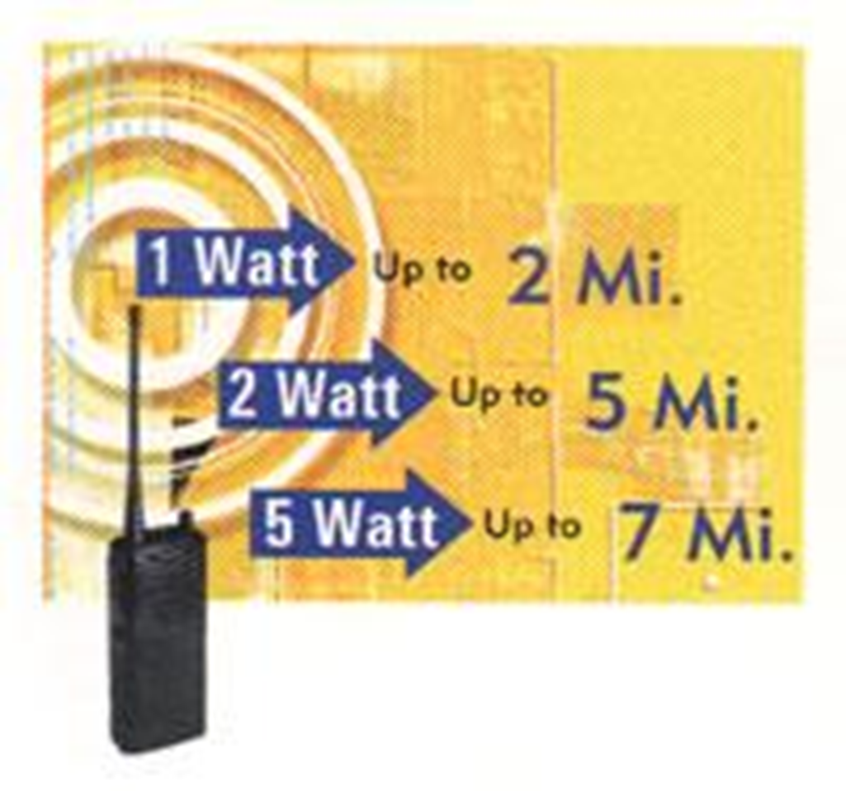
Simplex with a HT standing at ground level

Slide 36
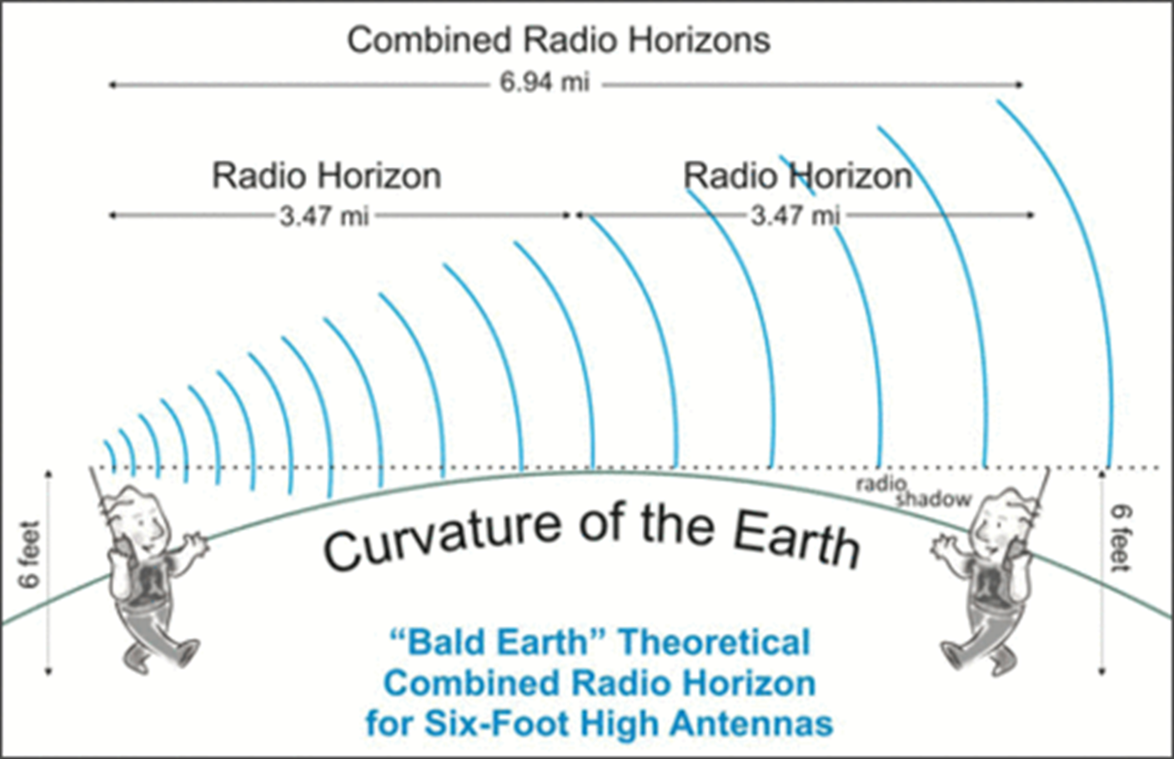
Simplex with a HT standing at ground level

Slide 37
More Common Terms
Duplex: A communication mode in which a radio transmits on one frequency and receives on another. Used when operating on a repeater.

Slide 38
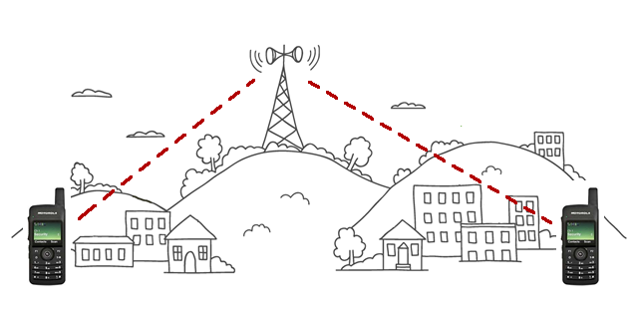
Duplex (Repeater)
Example: North Hills Radio Club Repeater located on a hill overlooking the Sacramento Valley. Highway 50 just east of the Bidwell Exit (Lower Eldorado Hills)
Repeater Input on 144.590 MHz (HT Transmit) needs a PL tone of 162.2 Hz to unlock repeater.
Repeater Output on 145.190 MHz (HT Receive) Repeater will send out a PL tone of 162.2 Hz if you wish to use tone squelch.

Slide 39
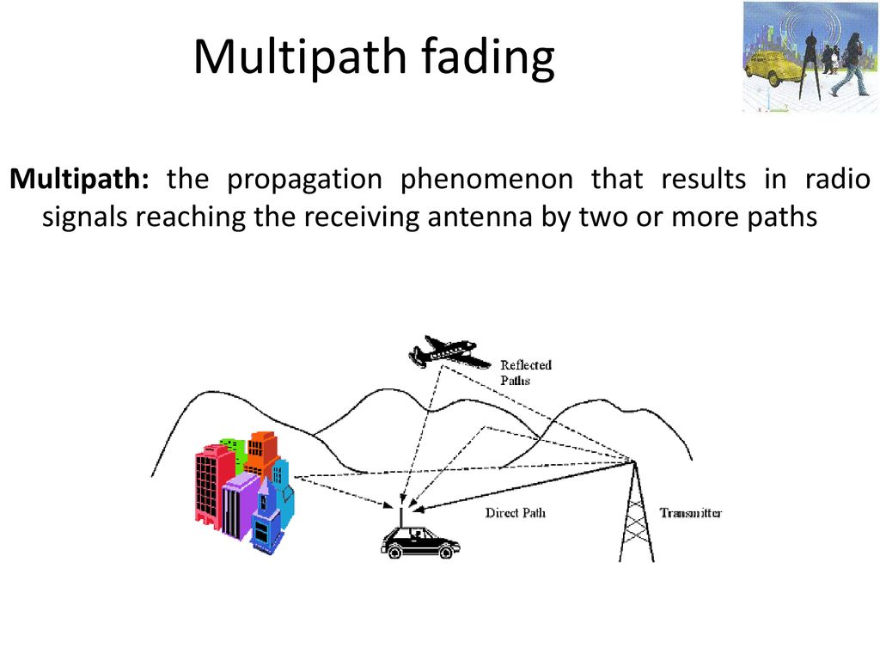

Slide 40
More Common Terms
Tone Squelch: A Squelch system that will not open (unlock) the squelch until the radio receives a tone that matches one preprogrammed into the radio. The tone is typically sub audio (below the audio capabilities of the radio) so it is not heard out the speaker.

Slide 41
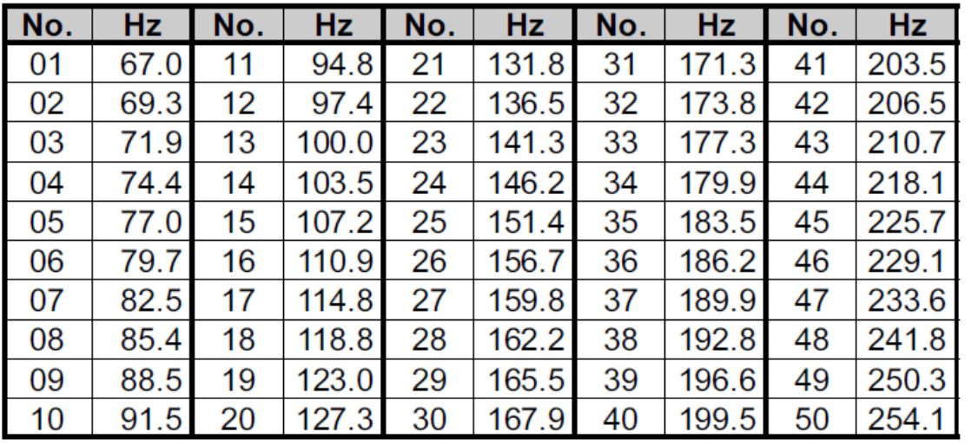
CTCSS: Continuous Tone Controlled Squelch System, the tone that works with Tone Squelch. Most commonly use to activate a repeater to reduce unauthorized use. There are 50 tones within the CTCSS tone set they range from 67.0Hz to 254.1Hz

Slide 42
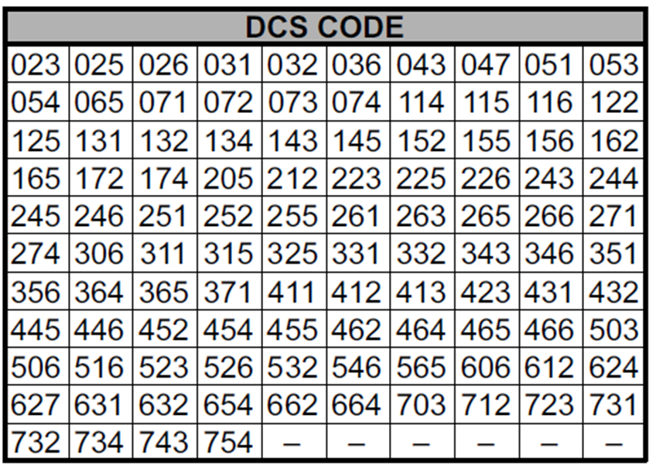
DCS: Digitally Controlled Squelch, similar to CTCSS but uses computer binary codes to operate the squelch system. There are 104 DCS codes. Advanced radios can be programmed to use both CTCSS and DCS simultaneously

Slide 43
Suggestion:
Note when operating with Tone Squelch or Digitally Controlled Squelch on, the radio will mask non-tone signals.
The frequency may be in use but you cannot here it.
I suggest you monitor the frequency before transmitting by pressing Moni Button on your Mike or HT body.

Slide 44
More Common Terms
Output Frequency: When operating in duplex mode (repeater) this is the frequency the repeater transmits out at and is the frequency your radio is set to receive on.
Input Frequency: When operating in duplex mode (repeater) this is the frequency the repeater receives on and is the frequency your radio is set to transmit on.

Slide 45
More Common Terms
Off Set: The amount of Hertz (Frequency) that differ between receive and transmit frequencies when your radio is set for duplex (repeater) operation. Typically 600KHz for 2 M and 5MHz for 70 cm. This allows the repeater to simultaneously receive and transmit at the same time.

Slide 46
More Common Terms
Negative Offset: When set to duplex your radio will transmit on a lower frequency then it receives on. Typical display when set is a “-“ (negative symbol)
Positive Offset: When set to duplex your radio will transmit on a higher frequency then it receives on. Typical display when set is a “+“ (positive symbol).
Repeater data books, web sites or Smart Phone Apps will list if the repeater is a positive or negative offset, its frequencies and CTCSS/DCS tone.

Slide 47
More Repeater Stuff
When calling a station on a repeater first give the ID (call sign) of the station your are calling followed by your call sign.
If you just give your Call Sign it is an open invitation to talk to anyone on the repeater.
Auto Patch is a way to connect the repeater to the phone line.
IRLP Internet Radio Linking Project allows the repeater to access other repeaters via the Internet. AKA Echolink.

Slide 48
Repeater Again
Example: North Hills Radio Club Repeater
Repeater Input is a negative offset of 600 KHz (HT Transmits on 144.590 MHz) needs a PL tone of 162.2 Hz to unlock repeater.
Repeater Output on 145.190 MHz (HT Receive) Repeater will send out a PL tone of 162.2 Hz if you wish to use tone squelch.

Slide 49
More Common Terms
Dual Band: A radio or antenna that can operate on two different frequency bands. Most common is VHF 2M and UHF 70 cm.

Slide 50
Memory: a location within the radio that can be programmed to remember a frequency (simplex) or frequencies and settings to operate on repeaters (duplex). Memory channels may be as few as 5 and as many as 1000 depending on the radio.
Yaesu FT-60r has 1000 memories.
Baofeng radios have 128 memories.
FT-8900 & TH-9800 have 800 memories
Channel Mode: Also known as memory mode. Recalls stored information within the memory.

Slide 51
More Common Terms
Home Channel: A memory programmed to a one-touch button that can quickly recall a favorite operating frequency (or Channel). (For Hi-Landers club members 146.565 MHz is recommended).

Slide 52
Scanner: A radio receiver which automatically tunes through a sequence of user selected frequencies. Ham radios can typically be set to Memory (Channel) scan or VFO (Frequency) scan.
Dual Watch: A two-channel scanning system which allows you to operate on any frequency/channel while periodically checking the Priority (or home) channel.
CW: Continuous Wave referring to a method of sending Morris Code.

Slide 53
Frequency and Bandwidth
Bandwidth: (true definition) is the difference between the upper and lower frequencies in a continuous set of frequencies.
In another word: it is the maximum space (in Frequency) a radio wave can occupy.

Slide 54
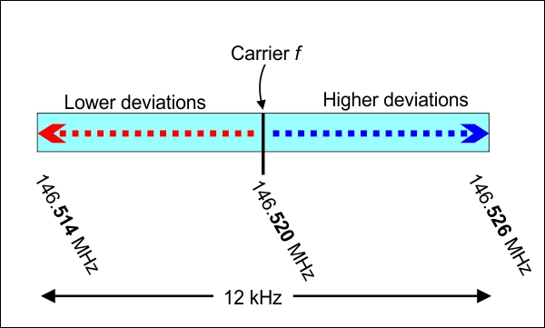
Frequency and Bandwidth

Slide 55
VHF & UHF FM Bandwidth
Wide Bandwidth: is channel spacing of 25 KHz was the original spacing.
Narrow Bandwidth: Is channel spacing of 12.5 KHz most business and government bands/frequencies were required to migrate to narrowband systems by January 1, 2013
VHF & UHF Ham Radios are Narrow Band
Narrow Narrow Bandwidth: (For lack of another name) has a spacing of 6.25 KHz

Slide 56
Suggested class supplies.
Note Book for taking notes.
Pens, Pencils and Erasers.
Non-programmable scientific calculator.
I suggest the TI-30XA for around $10, it is the one I will be using during class.

Slide 57
How to study
Repetition, repetition and more repetition.
Study, study, study
Read each test question and only the correct answer multiple times before you attempt any practice exams.
Take numerous practice exams before your VE session.

Slide 58
Study Hints
I suggest you read each question and only the correct answer. Read through the complete question pool at least three times before you attempt taking a practice exams. For higher impact and better results read the correct answer first then the question and again the correct answer.
The key to passing the exam is to get the most questions correct using the above method the correct response will often jump out at you on test day even if you don’t remember the question.

Slide 59
More Study Hints
If you don’t answer a question on the Exam it will be graded as a wrong response, so it is better to guess at a answer than leaving it blank. You have a 25% chance at guessing a correct answer. Eliminate one wrong response and now your guess has a 33% chance. Eliminate two wrong response and your guess is a 50% chance at being correct.

Slide 60
More Guessing Hints
The author of a question pays more attention on writing the correct response then they do to the wrong ones therefore the correct response is often a longer answer.
So when guessing consider the longest answer for it is “to long to be wrong”.

Slide 61
Things I have noticed
The response/answer
“All of these Answer (choices) are correct” shows up 68 times in element two question pool and is a correct response 23 times.
So when guessing don’t choose “all of these” for it will be correct response only 33% of the time.

Slide 62
Lets get started
Have your test pool questions ready and in front of you and please follow along with the next presentation.
The more questions you ask the better your understanding of the subject.
There is no such thing as a stupid question.
Ask, ask, ask

Slide 63
End of Introduction
Move onto Sub-Element one when ready

